Slide 1
Manchester
Raspberry Jam 25
January 2014

Slide 2
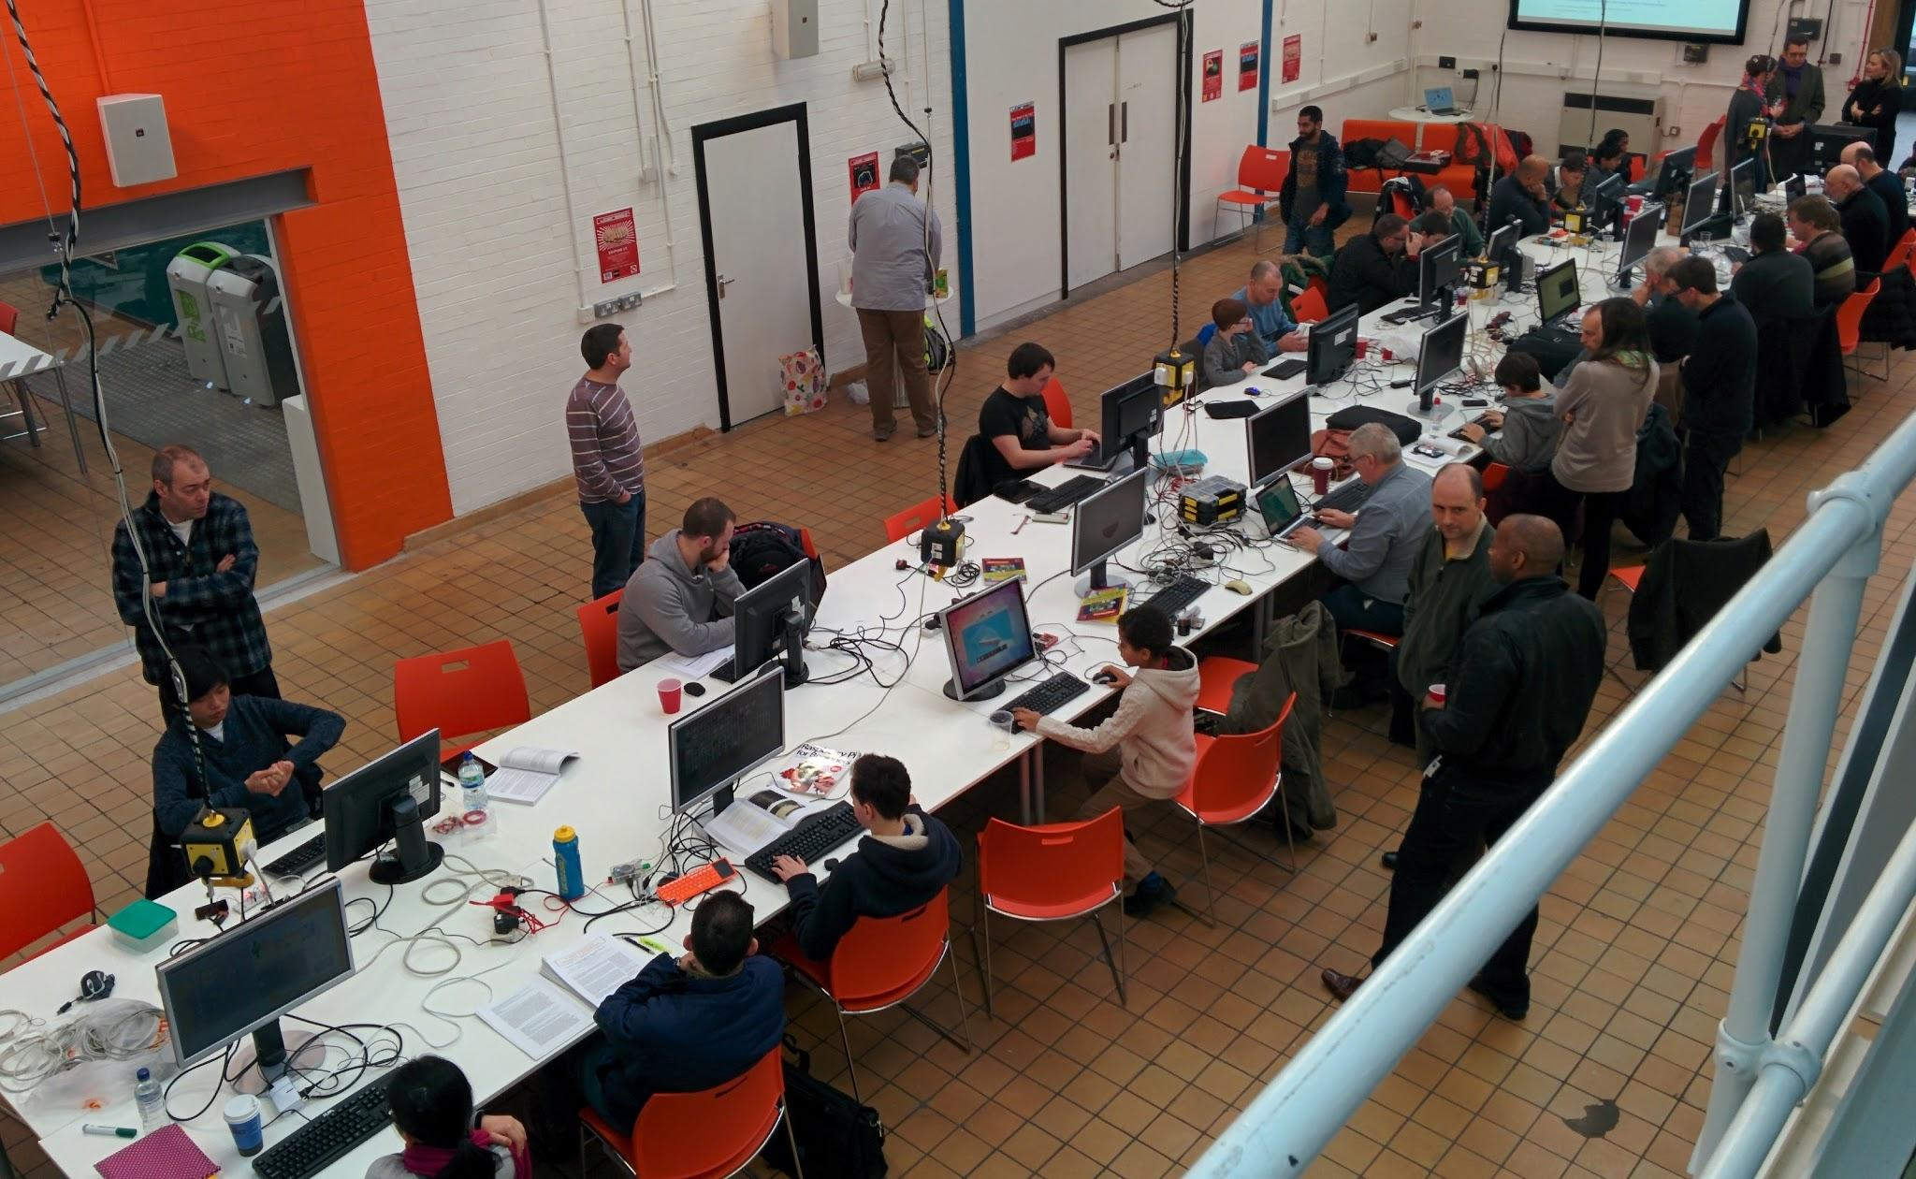
Last Time

Slide 3
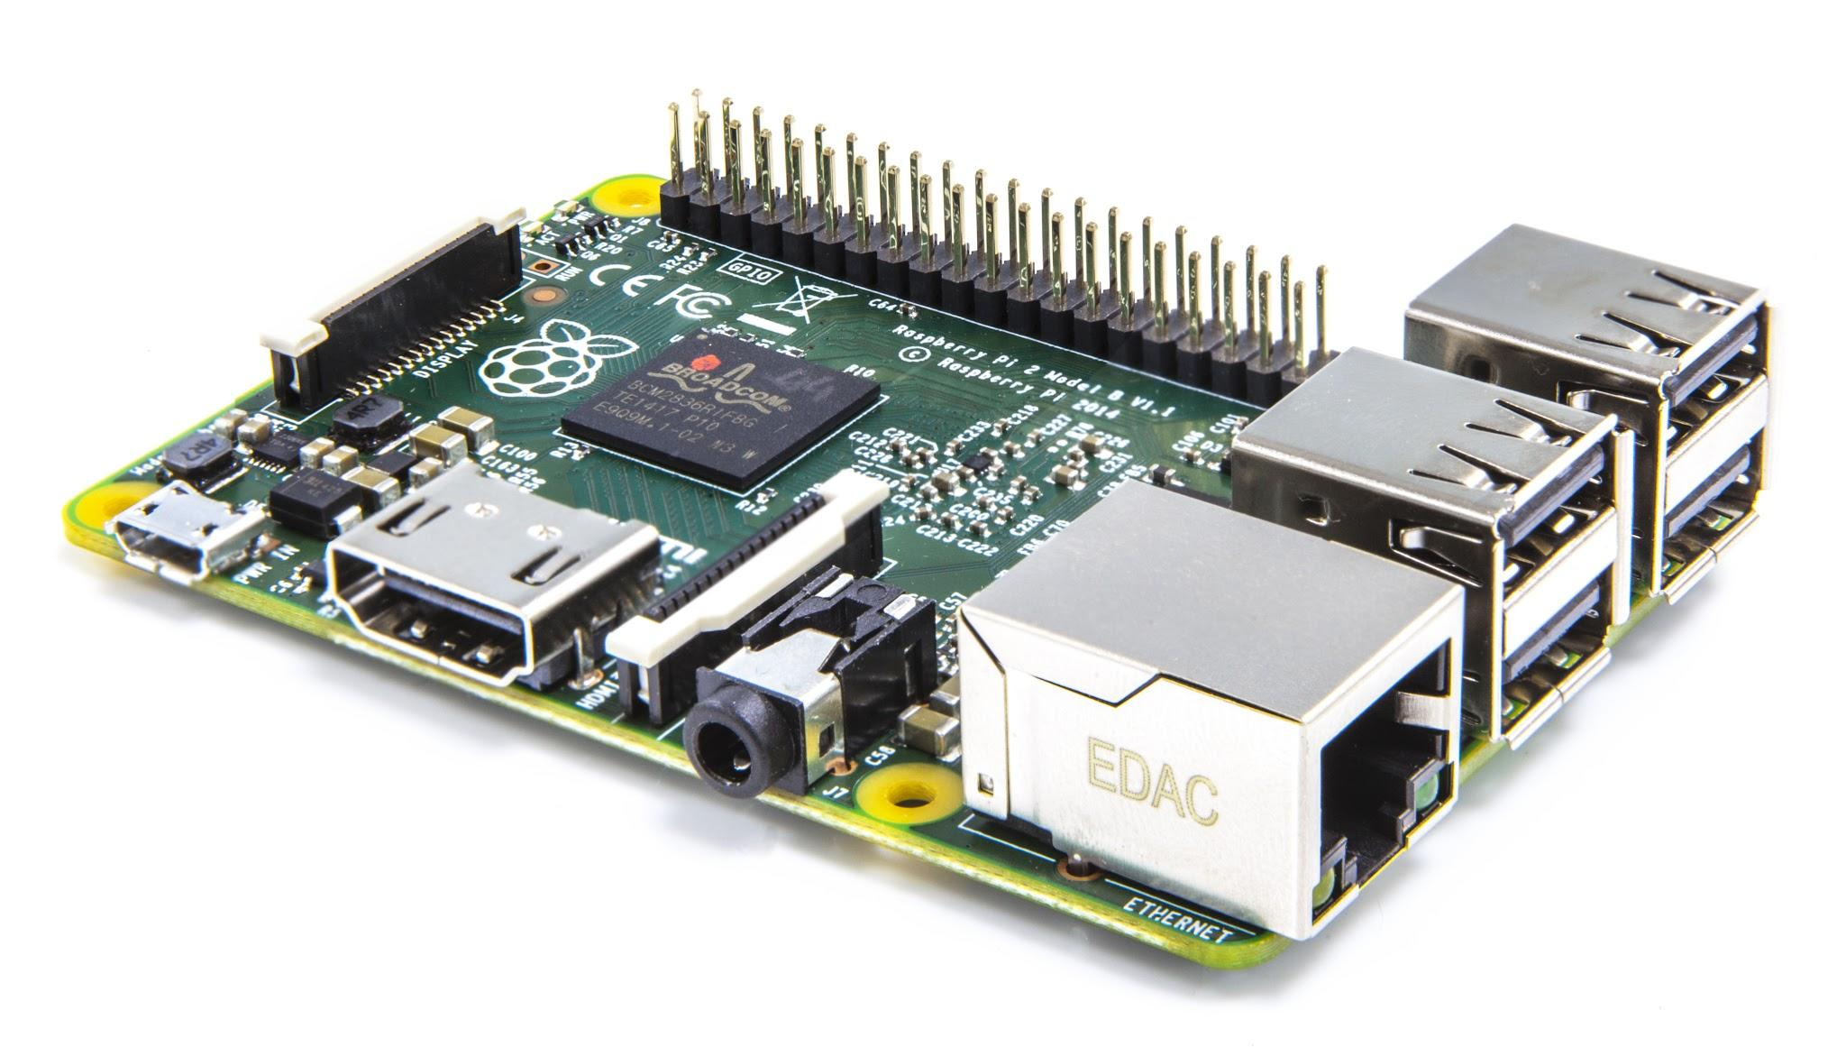
Raspberry Pi 2

Slide 4
Today:
Pizza at 1pm
Workshop at 11:30am
WiFi:
SSID MMU-Visitor
Pass. University
Next Month’s Jam: Saturday 7th March

Slide 5
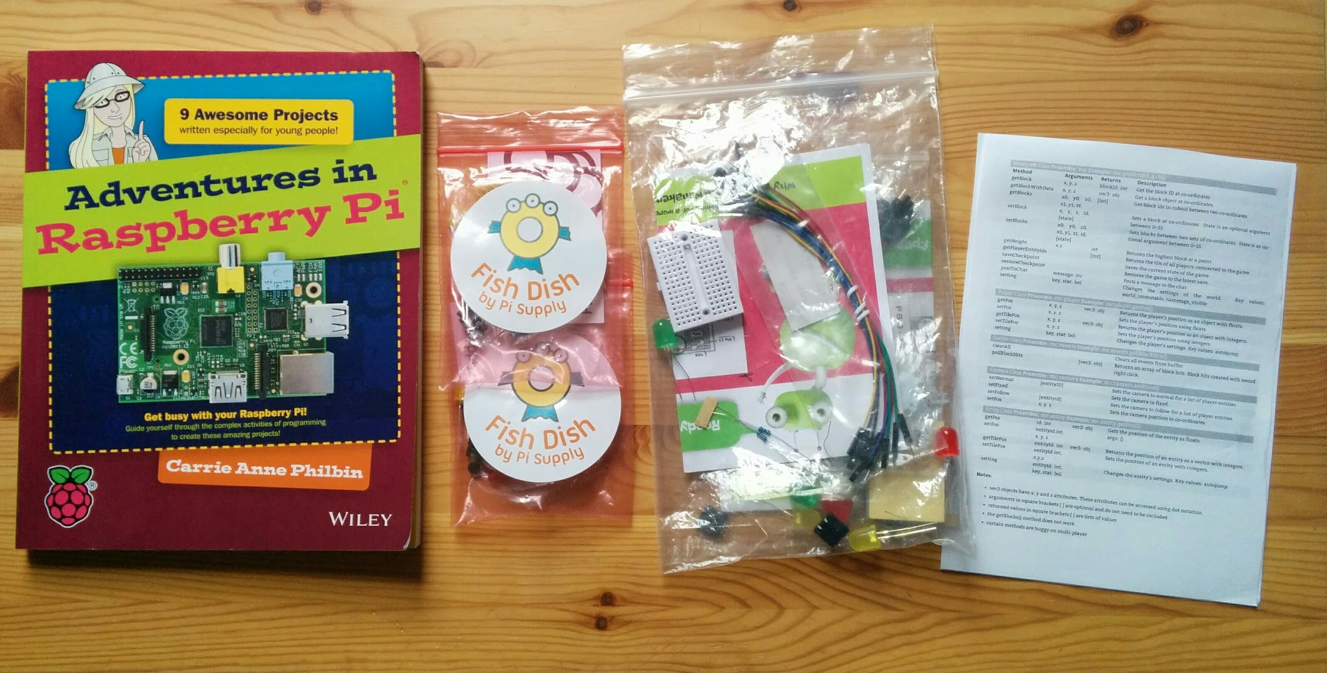
Stuck for ideas?
http://www.raspberrypi.org/introducing-raspberry-pi-model-b-plus/

Slide 6
Next Month...
Manchester Raspberry Jam 26
Saturday 7th February

